Slide 1
DASAR SISTEM INFORMASI
Dosen Pengampu :Riya W dan Kundang K Juman (pertemuan 7)
Fakultas Ilmu Komputer

Slide 2
Sistem Informasi menurut Level Organisasi
Functional Area Information Systems
Sistem informasi departemen
Contoh : Sistem Informasi SDM (HRIS)
Sistem informasi perusahaan (enterprise information system)
Contoh : sistem informasi perguruan tinggi
Sistem informasi antarorganisasi
Contoh : eCommerce

Slide 3
Functional Area Information Systems
Karakteristik SI (Kroenke, 1992)
Sistem informasi pribadi
Sistem informasi kelompok kerja (workgroup information system)
Sistem informasi perusahaan (enterprise information system)

Slide 4
Tabel Karakteristik
Functional Area Information Systems

Slide 5
Characteristics of Functional Information Systems
Comprises of several/tdd bbrp smaller information system
Specific IS applications
can be integrated utk membentuk fungsi coherent departmental system
can be completely/sepenuhnya independent
can be integrated Lintas departmental
Interface with each other to form/membentuk the organization wide information system
Interface with the environment/lingkungan

Slide 6
How to Integrated Information Systems
Connect existing systems (hub sist. yg ada)
memaksimalkan penggunaan sistem yang ada dan meminimalkan perubahan di dalamnya
memungkinkan penambahan aplikasi baru yang sudah ada
and the connection of systems to intranets and the Internet
Using supply chain management software
menggunakan satu paket terpadu dalam satu atau beberapa bidang fungsional
mengatasi isolasi struktur departemen tradisional di mana bidang fungsional dipisahkan dari satu sama lain

Slide 7
Integrated Information Systems
Reasons for Integration/alasan integrasi
using twentieth-century/abad ke 20 computer technology, which is functionally oriented :
cannot give employees all the information they need
do not let different departments communicate effectively with each other in the same language
crucial sales, inventory, and production data often have to be painstakingly entered manually into separate computer systems every time a person who is not a member of a specific department needs ac hoc information related to the specific department

Slide 8
Integrated Information Systems
Reasons for Integration/alasan integrasi
using twentieth-century/abad ke 20 computer technology, which is functionally oriented :
cannot give employees all the information they need do not let different departments communicate effectively with each other in the same language
cannot give employees all the information they need
penjualan penting, persediaan, dan data produksi sering harus susah payah dimasukkan secara manual ke dalam sistem komputer yang terpisah setiap kali orang yang bukan anggota dari departemen tertentu membutuhkan ac hoc informasi yang terkait dengan departemen tertentu

Slide 9
SI berdasarkan dukungan yang tersedia
Sistem Pemrosesan Transaksi (transaction processing system atau TPS)
Sistem Informasi Manajemen (management information system atau MIS)
Sistem Otomasi Perkantoran (office automation system atau OAS)
Sistem Pendukung Keputusan (decission support system atau DSS)
Sistem Informasi Eksekutif (executive information systematau EIS)
Sistem Pendukung Kelompok (group support system atau GSS)
Sistem Pendukung Cerdas (intelligent support system atau ISS)

Slide 10
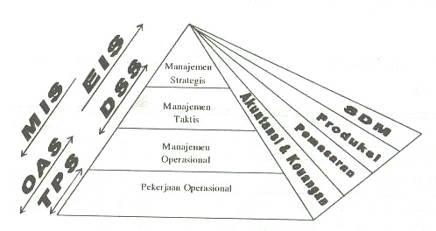
SI berdasarkan dukungan yang tersedia

Slide 11
Sistem Informasi Fungsional
Functional Area Information Systems
Sistem informasi berdasarkan area fungsional
Ditujukan untuk memberikan informasi bagi kelompok orang yang berada pada bagian tertentu dalam perusahaan

Slide 12
Functional Area Information Systems
Sistem Informasi Akuntansi (accounting information system)
Sistem Informasi Keuangan (finance information system)
Sistem Informasi Manufaktur (manufacturing / production information system)
Sistem Informasi Pemasaran (marketing information system)
Sistem Informasi SDM (human resources information system)

Slide 13
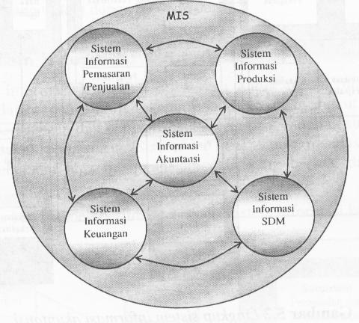
Functional Area Information Systems

Slide 14
Sistem Informasi Keuangan
SI yang menyediakan informasi pada fungsi keuangan yang menyangkut keuangan perusahaan.
Misal : Cash Flow dan informasi pembayaran

Slide 15
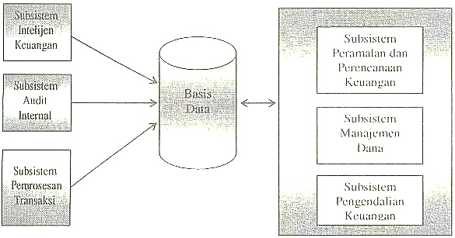
Model Sistem Informasi Keuangan

Slide 16

Accounting & Finance Systems
Financial Planning and Budgeting/penganggaran
Financial and Economic Forecasting
banyak indikator yang saling terkait tersedia di Internet
many software packages conducting/ygmelakukan forecasting and planning
Planning for Cash Management
build a decision support model
make decisions about when and how much to refinance/membiayai anggaran
Budgeting
Budget 2000 and Comshare BudgetPlus are available/tersedia to support budgeting and to facilitate communication among all participants/peserta in the preparation process

Slide 17
Accounting & Finance Systems (continued …)
Major activities
STRATEGIC SYSTEMS
a. Strategic Planning b. Ratios and Financial Health
c. Merger and Acquisition Analysis
INTERNAL
ENVIRONMENT
EXTERNAL
ENVIRONMENT
TACTIAL SYSTEMS
a. Budgeting Preparation and Control
b. Investment Management
c. Capital Budgeting d. Cost Analysis and Control
e. Tax Management f. Auditing
g. Financial Planning
Top Management
Operation/
Production
Marketing
HRM
Engineering
IRS
SEC
Vendors
Clients
CPA Companies
Suppliers
Customers
Business Partners
OPERATIONAL AND
TRANSACTION PROCESSING
SYSTEMS
a. The General Ledger b. Sales Order Processing
c. Accounts Payable and Receivable
d. Receiving and Shipping
e. Payroll f. Inventory Management
g. Periodical Reports & Statements

Slide 18


Accounting & Finance Systems (continued…)
Investment Management
Access to financial and economic reports
hundreds of sources for the financial and economic reports and news
Financial analysis
is executed with a spreadsheet program, or with commercially available/tersedia, ready-made decision support software

Slide 19

Accounting & Finance Systems (continued )
Financial Controls
Budgetary Controls
upaya perangkat lunak yang lebih canggih untuk pemenuhan Program pengeluaran
Auditing
perangkat lunak audit sangat cocok untuk sistem informasi terkomputerisasi yang diaudit
Financial Health Analysis
supported by expert systems
Profitability Analysis and Cost Control
perangkat lunak analisis profitabilitas memungkinkan perhitungan profitabilitas lbh akurat for individual products and organizations

Slide 20
Sistem Informasi Pemrosesan Transaksi
Transaction Processing System
Merupakan jenis SI yang pertama kali diimplementasikan
Fokus utamanya adalah pada data transaksi
Digunakan untuk menghimpun, menyimpan, dan memproses data transaksi

Slide 21
Characteristics of TPS
Large amounts/dlm jml bsr of data are processed
Sumber data sebagian besar internal and the output is intended mainly for audience internal / output ditujukan terutama untuk audience internal
The TPS processes information secara teratur
Large storage (database) capacity is required/diperlukan
High processing speed is needed because tingginya volume data
Input and output data are structured
High level of detail/tingkat tinggi detail is usually observable
Low computation complexity is usually terlihat/dpt diketahui
High level of accuracy, data integrity, and security is needed
High processing reliability/kehandalan is required
Inquiry/permintaan processing is a must/keharusan

Slide 22
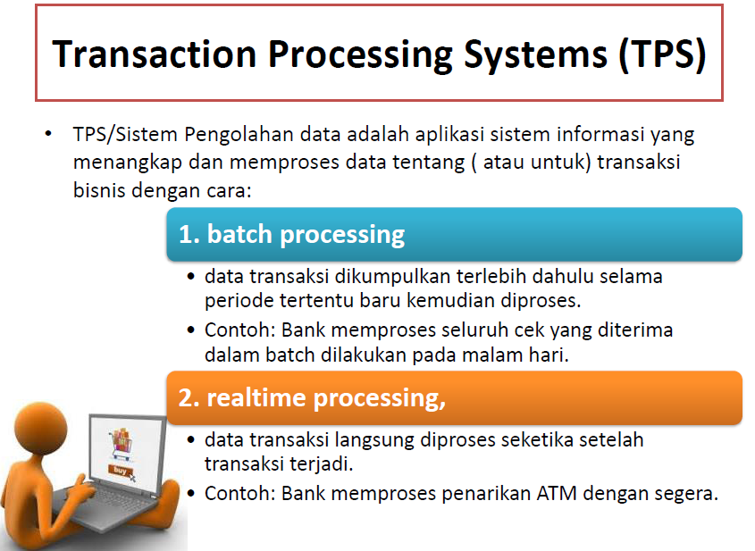

Slide 23
Beberapa pengembangan
OLTP (OnLine Transaction Processing)
Menggunakan arsitektur client-server
Lebih berkembang dengan adanya teknologi internet
CIS (Customer Integrated System)
Pelanggan dapat melaksanakan transaksinya sendiri
Contoh : ATM, B2C e-commerce
Inline (Pemrosesan hibrid)
Perpaduan antara batch dan online
Contoh : POS

Slide 24
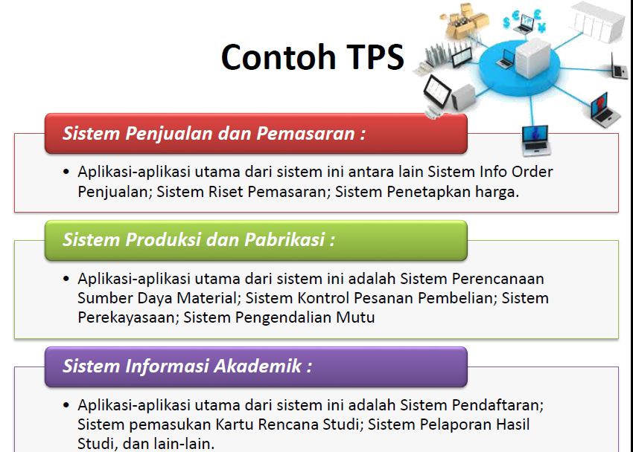

Slide 25
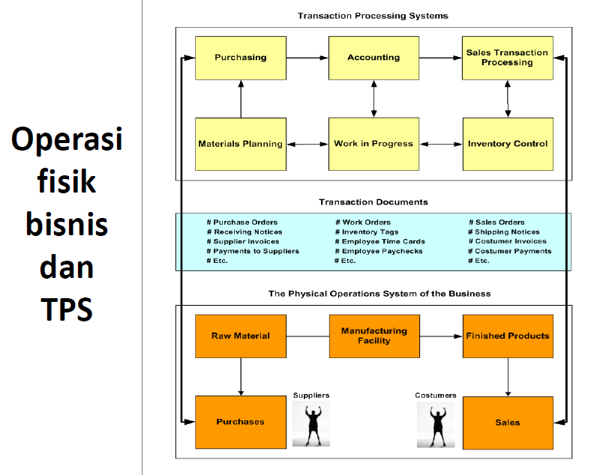

Slide 26
Transaction Processing Information Systems
Transaction Processing
major business processes
provide the mission-critical activities
transaction may generate/menghslkan additional transaction
simple transactions
large volume and repetitive/berulang transactions
Transaction Processing System (TPS)
Computerized/komputerisasi information system
supports the transaction processes

Slide 27
Sistem Informasi Manufaktur
SI yang bekerja sama dengan SI lain untuk mendukung manajemen perusahaan (perencanaan maupun pengendalian) dalam menyelesaikan masalah yang berhubungan dengan produk atau jasa yang dihasilkan
Misal : data bahan mentah, profil vendor baru, jadwal produksi

Slide 28
Implementasi CIM
Menyederhanakan proses produksi, perancangan produk, organisasi pabrik
Menotomasikan proses-proses produksi dan fungsi-fungsi bisnisnya
Mengintegrasikan seluru proses produksi dan pendukungnya.

Slide 29
CIM menggabungkan sistem produksi fisik (seperti robotika, CAM, kontrol mesin) dengan sistem informasi berbasis komputer
Sistem
Perencanaan
Sumber Daya
Manufaktur
Sistem
Pengendalian
Manufaktur
Sistem
Keteknikan
CAD / CAE
CAM
Simulasi dan
Prototipe Produk
CIM (Computer Integrated Manufacturing)

Slide 30
Production Operations & Logistics
Supply-Chain Management (SCM)
INFORMATION FLOW
Supplier
Transfer
Manufacturing
Transfer
Distribution
Transfer
Retail Outlet
SCM plans and controls the flow of information and cash
Retail
Transfer
Consumer
CASH FLOW

Slide 31
Production Operations & Logistics (continues …)
Logistics and Material Management
Inventory Management
Determining/menentukan how much inventory to keep/dijaga
what to order, from whom, when to order and how much
inventory model : economic order quantity (EOQ)
many low cost commercial inventory software packages (banyak paket perangkat lunak commercial inventory biaya murah)
Quality Control
Providing/memberikan information about the quality of incoming material and parts, as well as the quality of in-process semi-finished, and finished products
standard quality/mutu control information systems and expert systems

Slide 32
Production Operations & Logistics (continues …)
Planning Production/Operations
Material Requirements Planning (MRP) - facilitates the plan for acquiring parts, subassemblies, or material
Manufacturing Resource Planning (MRPII) - connects the regular MRP to other functional areas
Just-in-Time Systems - minimizes waste of all kinds, improves processes and systems, and maintains respect for all workers
Project Management - Program Evaluation and Review Technique (PERT) and Critical Path Method (CPM)
Short-Term Schedules - schedule jobs and employees on a daily or weekly basis

Slide 33
Production Operations & Logistics (Continues …)
Automatic Design Work and Manufacturing
Computer-Aided Design (CAD)
Enables/memungkinkan drawings to be constructed/dibangun on a computer screen and subsequently stored, manipulated, and updated electronically
Computer-Aided Manufacturing (CAM)
Facilitates/memfasilitasi planning, operation, and control of production jobs
Computer-Integrated Manufacturing (CIM)
concept or philosophy about the implementation of various integrated computer systems in factory automation

Slide 34
Sistem Informasi Pemasaran
SI yang menyediakan informasi yang dipakai oleh fungsi pemasaran
Misal : ringkasan penjualan
Mendukung keputusan yang berkaitan dengan bauran pemasaran (marketing mix), mencakup 4P :
Produk (product)
Tempat (place)
Promosi (promotion)
Harga (price)

Slide 35
Marketing & Sales Systems (continued ...)
Manufacturing
R & D/Design
COMPANY
Distribution
Accounting/
Finance
Market Intelligence
Systems
Dealer Systems
CHANNEL
SYSTEMS
Delivery Systems
Sales Systems
Target Marketing
Systems
Customer Support
Systems

Slide 36
Marketing & Sales (continued ...)
Customer Service
Customer Profiles and Preference Analysis
IT creates customer database and merges computerized lists
Mass Customization
Dell computers assembles computers according to the specifications of the buyers
J.C. Penny measures/mengukur you and transfers the data directly to the production floor
Targeted Advertisement on the Web
mencocokkan iklan yang sesuai with specific groups of customers
Customer Inquiry Systems and Automated Help Desk
expert systems and intelligent agents

Slide 37
Marketing & Sales (continued ...)
Telemarketing
Five major activities which are supported by IT :
advertisement and reaching/menjangkau customers
order processing ⬇ customer service
sales support ⬇ account management
Distribution Channels
Delivery management
DSS models are used to support decisions such as own outlets or distributors, and transportation mode
Improving/meningkatkan sales at retail stores/toko
IT reduces/mengurangi the long lines/antrian pjg in stores by reengineering/merekayasa ulang the checkout process

Slide 38
Marketing & Sales (continued ...)
Marketing Management
Pricing of Products or Services - online analytical processing is supporting pricing decisions
Salesperson Productivity - sales-force automation provides salespeople in the field/lapangan with portable computers, access to databases, and to the web
Product-Customer Profitability Analysis - a cost-accounting system, identifies profitable/m’untungkan customers and frequency
Sales Analysis and Trends - geographical information system (GIS) analyzes customers and competitors and examines/mengkaji potential strategies
New Products, Services, and Market Planning - IT evaluates large number/sejml bsr of factors and uncertainties and conducts/melakukan survey

Slide 39
Sistem Informasi SDM
SI yang menyediakan informasi yang dipakai oleh fungsi personalia
Misal : informasi gaji, ringkasan pajak, tunjangan-tunjangan, kinerja pegawai
Sering disebut dengan istilah :
HRIS (Human Resource Information)
HRMIS (Human Resource Management Information System)
HRMS (Human Resource Management System)

Slide 40
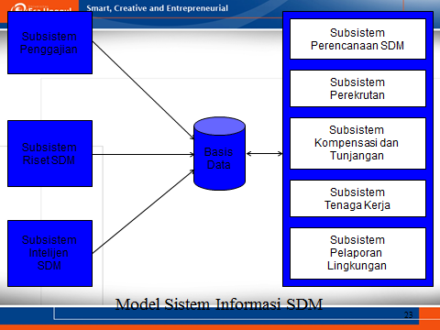
Model Sistem Informasi SDM

Slide 41
Human Resources Management Systems
Recruitment
Finding/menemukan, testing, and deciding/memutuskan which employees to hire/menyewa
Positions inventory
Matchin open positions with available/tersedia personnel
allowing/memungkinkan data to be viewed by an employee over the intranet
Employee Selection
Conducting/melakukan interviews by video teleconferencing
Expediting/mempercepat the testing and evaluation process, assuring/menjamin consistency in selection by using expert systems
Using the Internet
advertising position openings on the Internet

Slide 42
Human Resources Management Systems (continued )
Human Resources Maintenance and Development
Training and Human Resources Development
digital video-editing system : produces/menghslkan training videotapes / rekamanvido
Performance Evaluation
online evaluations - supports many decisions, ranging/mulai from rewards/hadiah to transfer to layoffs/peg,PHK
expert systems - memberikan interpretasi objektif dan sistematis kinerja dr wkt ke wkt
paperless wage/upah system (PWS) – tracks/melacak employee review/tinjauan dates and automatically initiates/mulai the wage review process
Turnover/omset, Tardiness/ketrlambatan, and Absensi Analyses
DSS models - identifies causes/penyebab and patterns/pola

Slide 43
Human Resources Management Systems (continued …)
Human Resources Management and Planning
Personal files and skills inventory - computerized personnel files, identify qualified/memenuhi syarat employees within the company for open positions, promotion, transfer, special training programs, and layoffs/PHK
Benefits administration - Networks and voice technology, or the intranets, menentukan nilai setiap benefit dan salda benefit yang tersedia of each employee
Government reports - Ketersediaan catatan personel terkomputerisasi sangat eases the reporting process

Slide 44
Human Resources Management Systems (continued …)
Personnel planning - IT is used to collect/mengumpulkan, update, and process the information
Succession planning and implementation - expert systems and personnel databases supporting and implementing planning
Labor-Management Negotiations – DSS meningkatkan iklim negosiasi dan sangat mengurang the time needed for reaching/mencapai an agreement/kesepakatan

Slide 45
Human Resources Management Systems (continued …)
Intranet Applications in HRM
Edify Corp.’s employee service system memajukan pendidikan
Oracle Corp.’s flexible benefits enrollment/pendaftaran program on the intranet
Online direktori Aetna Plan’s kesehatan, dokter perawatan primer, hospitals, medical services, and health information
Kegiatan pendidikan dan pengembangan ekstensif Apple Computers’ on the intranet
Merck Inc.’s intranet for HR transactions

Slide 46
MIS- Sistem Informasi Manajemen
Menyajikan informasi yang digunakan untuk mendukung operasi, manajemen, dan pengambilan keputusan dalam sebuah organisasi
Biasanya menghasilkan informasi untuk :
Memantau kinerja
Memelihara koordinasi
Operasi organisasi
Umumnya mengambil data dari sistem pemrosesan transaksi
Sering disebut sistem peringatan manajemen (management alerting system) – Haag, 2000; atau sistem pelaporan manajemen (management reporting system) – Zwass, 1998

Slide 47
Sistem Informasi Manajemen (MIS)
Basis
Data
Informasi
Untuk Pemakai
Sistem
Informasi
Manajemen

Slide 48
Management Information Systems
Memberikan informasi secara rutin kepada para manajer in the functional areas / dalam bidang fungsional
Memberikan informasi dalam laporan pengecualian dan hoc (demand) laporan.
Business
Transactions
Reports
Scheduled,
Exception,
Demand,
Others
Enterprise
Application
such as /spt.
EIS
TPS
A Management
Information
System
Databases
Internal,
External
Data
Warehouse
Functional
applications,
DSS

Slide 49
Klasifikasi SI menurut Aktivitas Manajemen
Sistem Informasi Pengetahuan
Sistem Informasi Operasional
Sistem Informasi Manajerial
Sistem Informasi Strategis

Slide 50


Enterprise Resource Planning System
Enterprise Resource Planning
Merupakan aplikasi bisnis terintegrasi (sistem informasi terintegrasi)
Memiliki modul-modul seperti pengendalian sediaan, utang dagang, piutang dagang, perencanaan kebutuhan material hingga penanganan sumber daya manusia
Perangkat lunak ERP yang terkenal :
SAP
Baan
Oracle
PeopleSoft

Slide 51
Enterprise Software (continued …)
System Anwendung Produket (SAP)
Salah satu vendor terbesar (memegang 30% dari pasar perangkat lunak perusahaan)
strength : ❶ dukungan integrasi tingkat tinggi ❷ support for multi-site, multi-currency operations/operasi multi-mata uang
R / 3 – flagship/unggulan client/server product
memiliki tingkat integrasi fungsional yg tinggi di seluruh perusahaan
criticism : complex, memakan waktu dan mahal untuk menginstal dan mengintegrasikan dengan sistem lain
decoupling the models of R/3 ke dalam komponen terpisah, masing-masing dengan database sendiri

Slide 52
Enterprise Software (continued …)
Difficulty in Most/kebykan Organizations
Kekompleksitasan yang muncul dari semua jenis hardware dan software yang mereka gunakan.
Package Wanted/dicari by an Organization
Dukungan integrasi antara modul fungsional (yaitu, sumber daya manusia, operasi, pemasaran, keuangan, akuntansi, dll)
Cepat diubah atau ditingkatkan
Menyajikan grafis umum look-and-feel
Membantu mengurangi biaya pelatihan dan operasi

Slide 53
ERP System /Enterprise Software
Enterprise Software : SAP
Mengelola operasi penting perusahaan, seperti manajemen rantai pasokan (pergerakan bahan baku dari pemasok melalui pengiriman barang jadi ke pelanggan), penambahan persediaan, pemesanan, koordinasi logistik, manajemen sumber daya manusia, manufaktur, operasi, akuntansi, dan manajemen keuangan

Slide 54
ERP SYSTEM (CONTINUE...)
SAP concept
Sales
Offices
Central SAP
Database &
Servers
The factory automati-
cally receives the
sales order and can
begin production.
FACTORY
The warehouse is si-
multaneously informed
about the order and
can schedule shipping.
WAREHOUSE
Accounting gets up-
dated sales and pro-
duction data at every
step of the process
ACCOUNTING
HEAD QUARTERS
Headquarters can tap
into up-to-the-minute
data on sales, inven-
tory, and production

Slide 55
How to Integrated Information Systems (continued …)
Enterprise resource planning (ERP)
control all major business processes with a single software architecture in real time/sec.real time
Increased/meningkatkan efficiency to improved /meningkatkan quality, productivity, and profitability
SAP software (R|3; my SAP.com)
crosses functional departments and dapat diperpanjang sepanjang rantai pasokan untuk kedua pemasok dan pelanggan
composed /tdd of four major parts : accounting, manufacturing, sales and human resources

Slide 56
Enterprise Information Systems
Evolved from Executive Information Systems combined with Web technologies
EIPs view information across entire organizations
Provide rapid access to detailed information through drill-down.
Provide user-friendly interfaces through portals.
Identifies opportunities and threats

Slide 57
Enterprise Information Systems
Specialized systems include ERM, ERP, CRM, and SCM
Provides timely and effective corporate level tracking and control.
Filter, compress, and track critical data and information.

Slide 58
Knowledge Management Systems
Knowledge that is organized and stored in a repository for use by an organization
Can be used to solve similar or identical problems in the future
ROIs as high as a factor of 25 within one to two years

Slide 59
Expert Systems
Technologies that apply reasoning methodologies in a specific domain
Attempts to mimic human experts’ problem solving
Examples include:
Artificial Intelligence Systems
Artificial Neural Networks (neural computing)
Genetic Algorithms
Fuzzy Logic
Intelligent Agents

Slide 60
Hybrid Support Systems
Integration of different computer system tools to resolve problems
Tools perform different tasks, but support each other
Together, produce more sophisticated answers
Work together to produce smarter answers

Slide 61
Emerging Technologies
Grid computing
Improved GUIs
Model-driven architectures with code reuse
M-based and L-based wireless computing
Intelligent agents
Genetic algorithms
Heuristics and new problem-solving techniques

Slide 62
Management Science/Operations Research
Adopts systematic approach
Define problem
Classify into standard category
Construct mathematical model
Evaluate alternative solutions
Select solution

